Slide 1
Programming with MATLAB

Slide 2
Objectives
Learning how to create well-documented M-files in the edit window and invoke them from the command window.
Understanding how script and function files differ.
Understanding how to incorporate help comments in functions.
Knowing how to set up M-files so that they interactively prompt users for information and display results in the command window.
Understanding the role of subfunctions and how the are accessed.
Knowing how to create and retrieve data files.

Slide 3
M-files
While commands can be entered directly to the command window, MATLAB also allows you to put commands in text files called M-files. M-files are so named because the files are stored with a .m extension.
There are two main kinds of M-file
Script files
Function files

Slide 4
Script Files
A script file is merely a set of MATLAB commands that are saved on a file - when MATLAB runs a script file, it is as if you typed the characters stored in the file on the command window.
Scripts can be executed either by typing their name (without the .m) in the command window, by selecting the Debug, Run (or Save and Run) command in the editing window, or by hitting the F5 key while in the editing window. Note that the latter two options will save any edits you have made, while the former will run the file as it exists on the drive.

Slide 5
Function Files
Function files serve an entirely different purpose from script files. Function files can accept input arguments from and return outputs to the command window, but variables created and manipulated within the function do not impact the command window.

Slide 6
Function File Syntax
The general syntax for a function is:
function outvar = funcname(arglist) % helpcomments statements outvar = value;
where
outvar: output variable name
funcname: function’s name
arglist: input argument list; comma-delimited list of what the function calls values passed to it
helpcomments: text to show with help funcname
statements: MATLAB commands for the function

Slide 7
Subfunctions
A function file can contain a single function, but it can also contain a primary function and one or more subfunctions
The primary function is whatever function is listed first in the M-file - its function name should be the same as the file name.
Subfunctions are listed below the primary function. Note that they are only accessible by the main function and subfunctions within the same M-file and not by the command window or any other functions or scripts.

Slide 8
Input
The easiest way to get a value from the user is the input command:
n = input('promptstring') MATLAB will display the characters in promptstring, and whatever value is typed is stored in n. For example, if you type pi, n will store 3.1416…
n = input('promptstring', 's') MATLAB will display the characters in promptstring, and whatever characters are typed will be stored as a string in n. For example, if you type pi, n will store the letters p and i in a 2x1 char array.

Slide 9
Output
The easiest way to display the value of a matrix is to type its name, but that will not work in function or script files. Instead, use the disp command
disp(value)
will show the value on the screen.
If value is a string, enclose it in single quotes.

Slide 10
Formatted Output
For formatted output, or for output generated by combining variable values with literal text, use the fprintf command:
fprintf('format', x, y,...)
where format is a string specifying how you want the value of the variables x, y, and more to be displayed - including literal text to be printed along with the values.
The values in the variables are formatted based on format codes.

Slide 11
Format and Control Codes
Within the format string, the following format codes define how a numerical value is displayed: %d - integer format %e - scientific format with lowercase e %E - scientific format with uppercase E %f - decimal format %g - the more compact of %e or %f
The following control codes produce special results within the format string: \n - start a new line \t - tab \\ - print the \ character
To print a ' put a pair of ' in the format string

Slide 12
Creating and Accessing Files
MATLAB has a built-in file format that may be used to save and load the values in variables.
save filename var1 var2 ... varn saves the listed variables into a file named filename.mat. If no variable is listed, all variables are saved.
load filename var1 var2 ...varn loads the listed variables from a file named filename.mat. If no variable is listed, all variables in the file are loaded.
Note - these are not text files!

Slide 13
ASCII Files
To create user-readable files, append the flag -ascii to the end of a save command. This will save the data to a text file in the same way that disp sends the data to a screen.
Note that in this case, MATLAB does not append anything to the file name so you may want to add an extension such as .txt or .dat.
To load a rectangular array from a text file, simply use the load command and the file name. The data will be stored in a matrix with the same name as the file (but without any extension).

Slide 14
Structured Programming
Structured programming allows MATLAB to make decisions or selections based on conditions of the program.
Decisions in MATLAB are based on the result of logical and relational operations and are implemented with if, if…else, and if…elseif structures.
Selections in MATLAB are based on comparisons with a test expression and are implemented with switch structures.

Slide 15
Relational Operators
From Table 3.2: Summary of relational operators in MATLAB:
Example | Operator | Relationship
x == 0 | == | Equal
unit ~= ‘m’ | ~= | Not equal
a < 0 | < | Less than
s > t | > | Greater than
3.9 <= a/3 | <= | Less than or equal to
r >= 0 | >= | Greater than or equal to

Slide 16
Logical Operators
~x (Not): true if x is false (or zero); false otherwise
x & y (And): true if both x and y are true (or non-zero)
x || y (Or): true if either x or y are true (or non-zero)

Slide 17
Order of Operations
Priority can be set using parentheses. After that, Mathematical expressions are highest priority, followed by relational operators, followed by logical operators. All things being equal, expressions are performed from left to right.
Not is the highest priority logical operator, followed by And and finally Or
Generally, do not combine two relational operators! If x=5, 3<x<4 should be false (mathematically), but it is calculated as an expression in MATLAB as: 3<5<4, which leads to true<4 at which point true is converted to 1, and 1<4 is true!
Use (3<x)&(x<4) to properly evaluate.

Slide 18
Decisions
Decisions are made in MATLAB using if structures, which may also include several elseif branches and possibly a catch-all else branch.
Deciding which branch runs is based on the result of conditions which are either true or false.
If an if tree hits a true condition, that branch (and that branch only) runs, then the tree terminates.
If an if tree gets to an else statement without running any prior branch, that branch will run.
Note - if the condition is a matrix, it is considered true if and only if all entries are true (or non-zero).

Slide 19
Selections
Selections are made in MATLAB using switch structures, which may also include a catch-all otherwise choice.
Deciding which branch runs is based on comparing the value in some test expression with values attached to different cases.
If the test expression matches the value attached to a case, that case’s branch will run.
If no cases match and there is an otherwise statement, that branch will run.

Slide 20
Loops
Another programming structure involves loops, where the same lines of code are run several times. There are two types of loop:
A for loop ends after a specified number of repetitions established by the number of columns given to an index variable.
A while loop ends on the basis of a logical condition.

Slide 21
for Loops
One common way to use a for…end structure is:
for index = start:step:finish statements end
where the index variable takes on successive values in the vector created using the : operator.

Slide 22
Vectorization
Sometimes, it is more efficient to have MATLAB perform calculations on an entire array rather than processing an array element by element. This can be done through vectorization.
for loop | Vectorization
i = 0; for t = 0:0.02:50 i = i + 1; y(i) = cos(t); end | t = 0:0.02:50; y = cos(t);

Slide 23
while Loops
A while loop is fundamentally different from a for loop since while loops can run an indeterminate number of times. The general syntax is
while condition statements end
where the condition is a logical expression. If the condition is true, the statements will run and when that is finished, the loop will again check on the condition.
Note - though the condition may become false as the statements are running, the only time it matters is after all the statements have run.

Slide 24
Early Termination
Sometimes it will be useful to break out of a for or while loop early - this can be done using a break statement, generally in conjunction with an if structure.
Example:
x = 24 while (1) x = x - 5 if x < 0, break, end end
will produce x values of 24, 19, 14, 9, 4, and -1, then stop.

Slide 25
Animation
Two ways to animate plots in MATLAB:
Using looping with simple plotting functions
This approach merely replots the graph over and over again.
Important to use the axis command so that the plots scales are fixed.
Using special function: getframe and movie
This allows you to capture a sequence of plots (getframe) and then play them back (movie).

Slide 26
Example
The (x, y) coordinates of a projectile can be generated as a function of time, t, with the following parametric equations
x = v₀ cos(θ₀ t)
y = v₀ sin(θ₀ t) − 0.5 gt²
where v₀ = initial velocity (m/s)
θ₀ = initial angle (radians)
g = gravitational constant (= 9.81 m/s²)

Slide 27
Script
The following code illustrates both approaches:
clc,clf,clear
g=9.81; theta0=45*pi/180; v0=5;
t(1)=0;x=0;y=0;
plot(x,y,'o','MarkerFaceColor','b','MarkerSize',8)
axis([0 3 0 0.8])
M(1)=getframe;
dt=1/128;
for j = 2:1000
t(j)=t(j-1)+dt;
x=v0*cos(theta0)*t(j);
y=v0*sin(theta0)*t(j)-0.5*g*t(j)^2;
plot(x,y,'o','MarkerFaceColor','b','MarkerSize',8)
axis([0 3 0 0.8])
M(j)=getframe;
if y<=0, break, end
end
pause
movie(M,1)

Slide 28
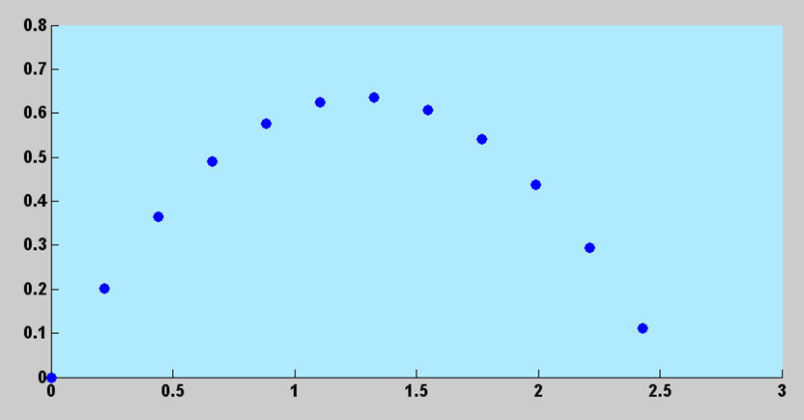
Result

Slide 29
Nesting and Indentation
Structures can be placed within other structures. For example, the statements portion of a for loop can be comprised of an if...elseif...else structure.
For clarity of reading, the statements of a structure are generally indented to show which lines of controlled are under the control of which structure.

Slide 30
Anonymous & Inline Functions
Anonymous functions are simple one-line functions created without the need for an M-file fhandle = @(arg1, arg2, ...) expression
Inline functions are essentially the same as anonymous functions, but with a different syntax: fhandle = inline('expression', 'arg1', 'arg2',...)
Anonymous functions can access the values of variables in the workspace upon creation, while inlines cannot.

Slide 31
Function Functions
Function functions are functions that operate on other functions which are passed to it as input arguments. The input argument may be the handle of an anonymous or inline function, the name of a built-in function, or the name of a M-file function.
Using function functions will allow for more dynamic programming.

